Slide 1
Zurich
Single Lock-In
Lee Jong Geon

Slide 2
Last Points
MATLAB
Algorithm 최적 하드웨어 추천은 어려움
License가 학교에서 제공된 것 ➔ 부가 서비스 권한이 없음
Consulting Program ➔ 비용
Zurich Single Lock In Amp.
Internal oscillator가 있어 internal reference가 가능
External reference를 사용하기 위해서는 PLL (Phase Locked Loop)를 사용

Slide 3
Single Lock-In
SR830
Mixer
Reference Signal
PLL
Zurich HF2LI
Mixer
Reference Signal
PLL
LPF
(Time const., order)
PID Controller
(P, I, D)
➔ Auto Setting

Slide 4
Single Lock-In
Device Connection
PLL에서 freq.와 phase 정보를 얻으면 내부 oscillator에서 이를 다시 구현하여 lock-in mixer에 입력한다.
Function Generator
(External reference)
output
Zurich HF2LI
Input 1
Output 1
Input 2
Output 2

Slide 5
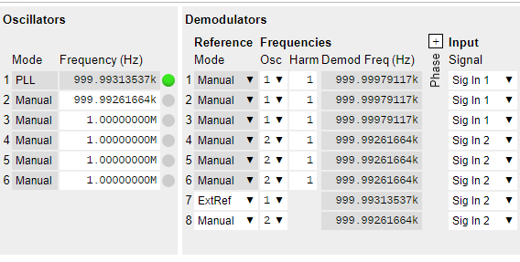
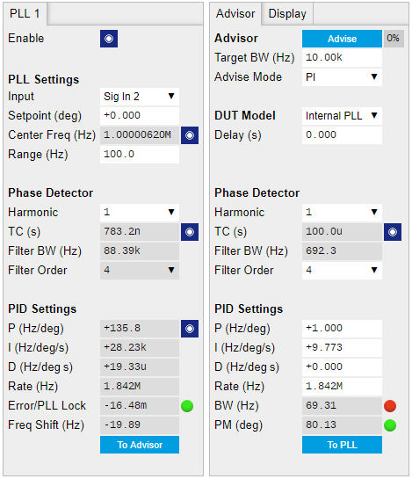
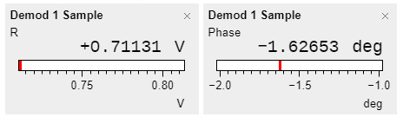
Single Lock-In
LabOne Setting

Slide 6
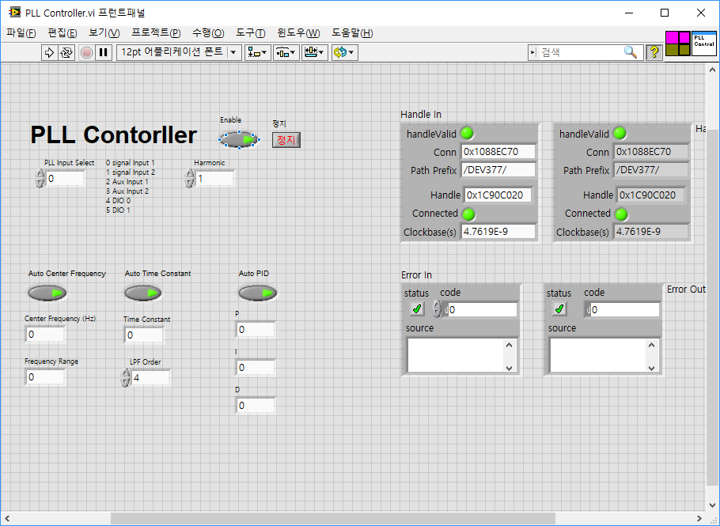
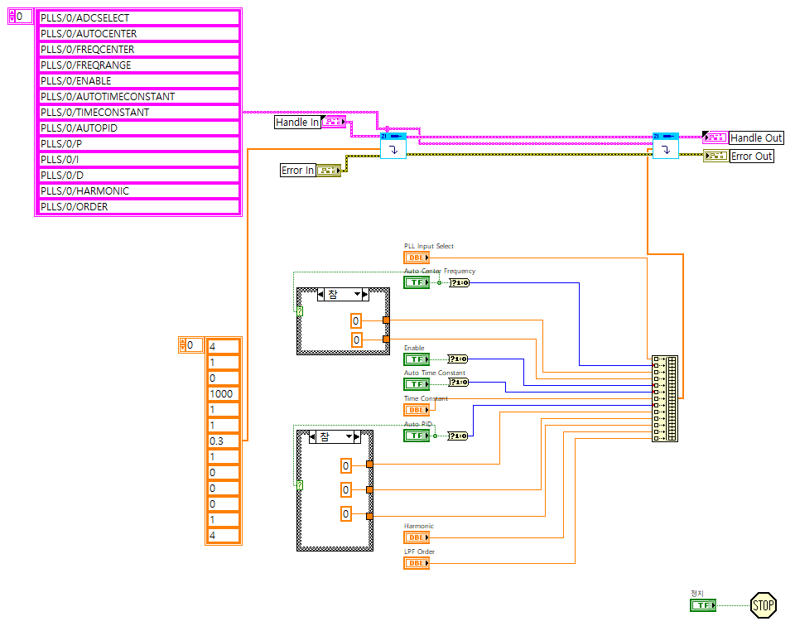
Single Lock-In
LabVIEW Setting
Center frequency, time constant, PID
Auto setting
Demodulator의 mode를 변경시키는 node 없음
➔ LabOne과 동기화 되어 연결되어야 하는지 확인 필요

Slide 7
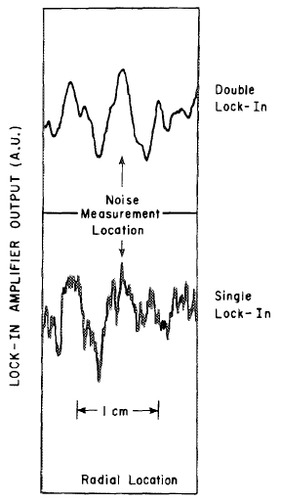
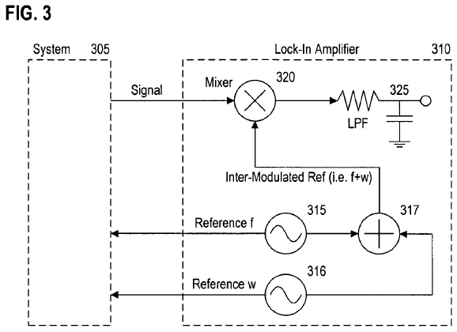
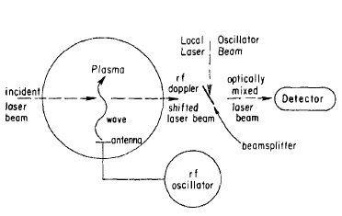
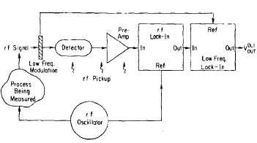


Dual Lock-In
Patent Data
Paper
$$f_{1}=12.5MHz, f_{2}=520Hz$$
$$τ_{1}=500μs, τ_{2}=4s$$
$$\frac{SNR^{DLI}}{SNR^{SLI}}≅20$$
U.S. Patent No. US 7590196 B2. (2005). Washington, DC: U.S. Patent and Trademark Office.
Review of Scientific Instruments 56, 1662 (1985); doi: 10. 1063/1.1138121

Slide 8
Week Plan
 | May 5th wk. | June 1st wk. | June 2nd wk. | June 3rd wk. | June 4th wk.
PLL
Single LI Scope & Test
Dual LI Mixer Design
Dual LI Scope & Test

